Slide 1
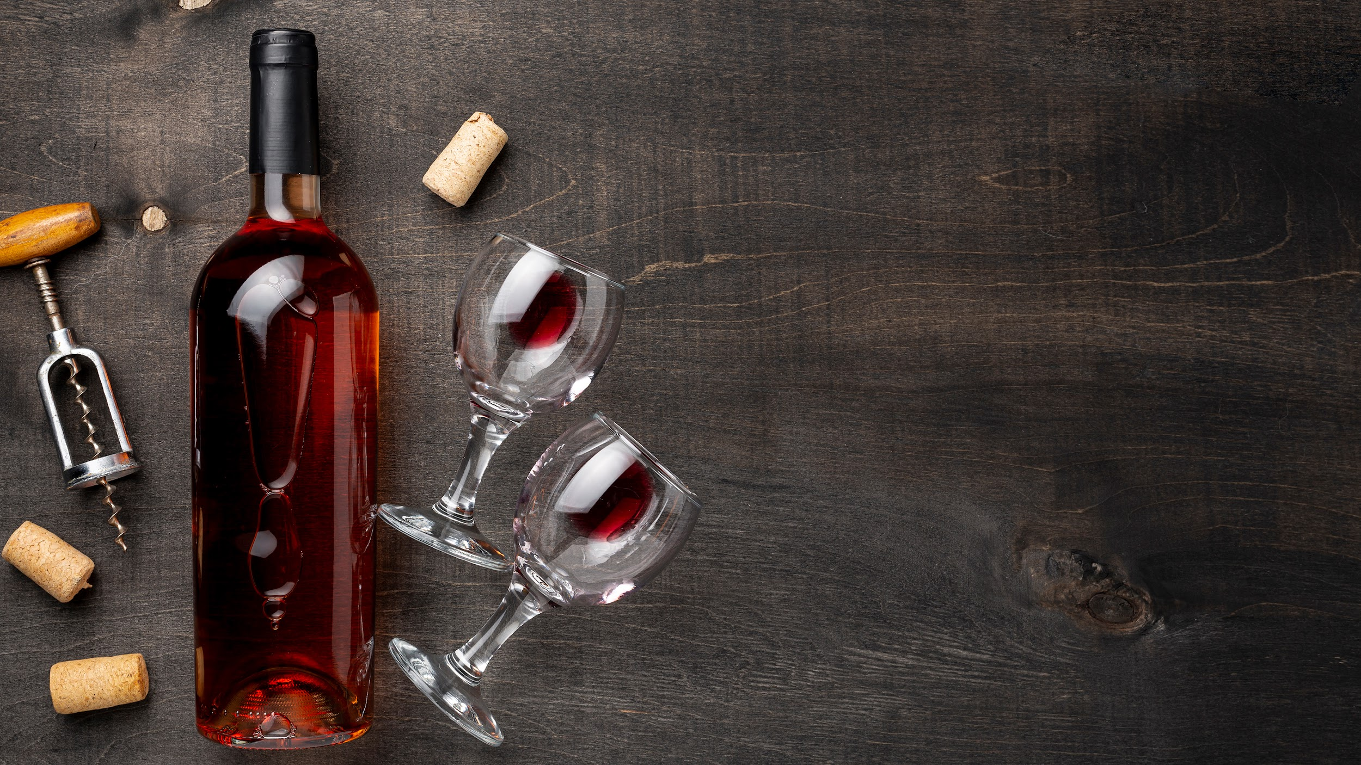
HOW TO MAKE A GOOD WINE RED QUALITY
Present by: Nhat Phuc, Data Science Class, CoderSchool

Slide 2
MAIN CONTENT
What makes a quality wine
1
Analysis of factors affecting red wine quality
2
3
Predict red wine quality using machine learning model

Slide 3
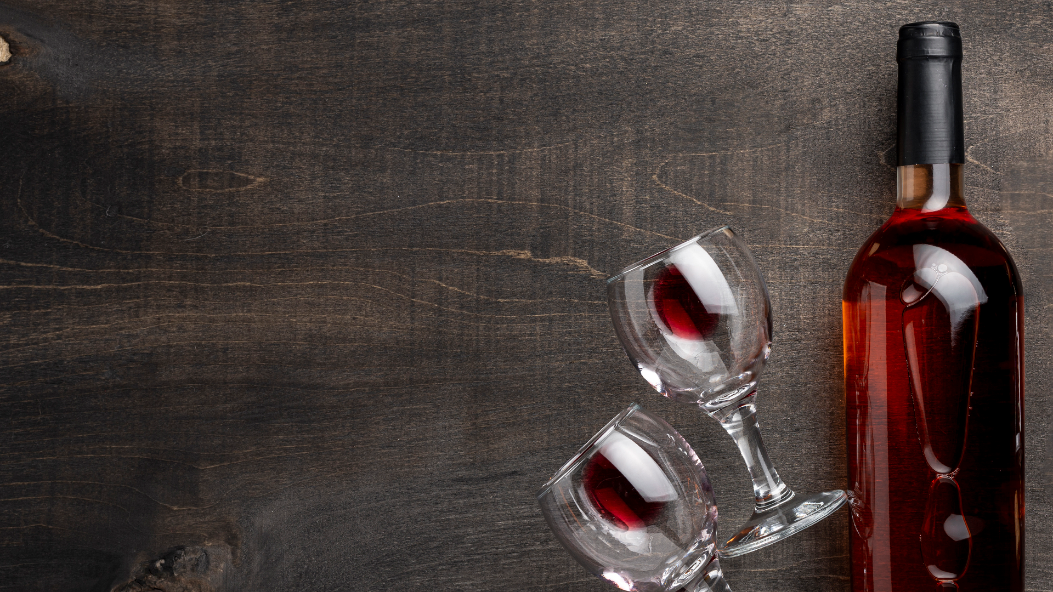
INTRODUCTION
Red wine is a type of wine made from dark-colored grape varieties. It is produced by fermenting the grape juice along with the grape skins, seeds, and sometimes even the stems. The color of red wine ranges from light red to deep purple, depending on the grape variety and the winemaking process.
Notes:
Rượu vang đỏ là loại rượu được làm từ giống nho có màu sẫm. Nó được sản xuất bằng cách lên men nước nho cùng với vỏ nho, hạt và đôi khi là cả thân cây. Màu của rượu vang đỏ dao động từ đỏ nhạt đến tím đậm, tùy thuộc vào giống nho và quy trình sản xuất rượu vang.

Slide 4
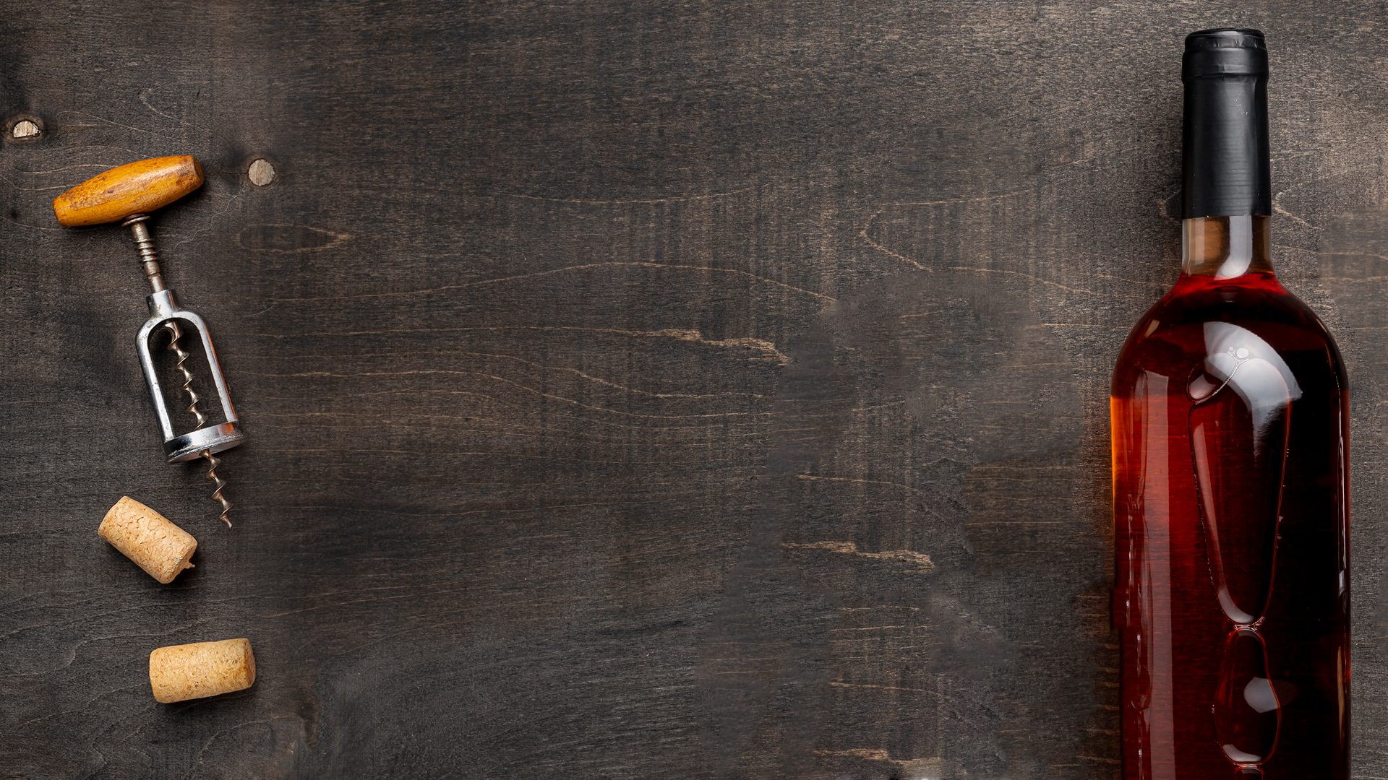
01.
What makes a quality wine

Slide 5

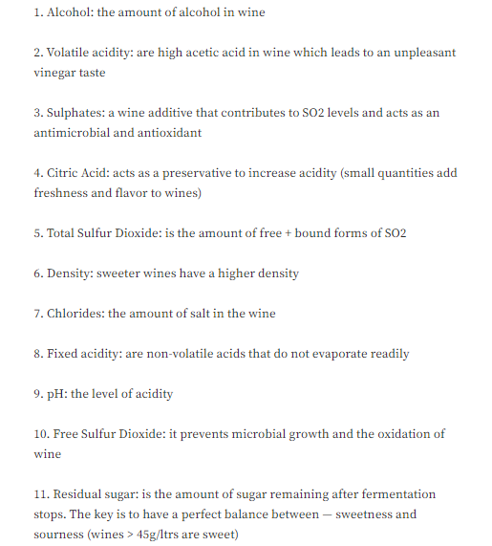
The FacTORS
There are 11 factors affecting red wine quality base on dataset

Slide 6
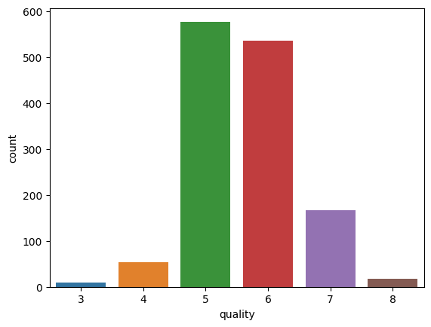
wine quality classification
The highest percentages of wine are found among those with quality ratings of 5 and 6, proving that it is more popular than others type

Slide 7
WhAT makes a quality wine
There is an official formula that wine tasters use to determine the quality of taste:
Sweet Taste (sugars + alcohols) <= => Acid Taste (acids) + Bitter Taste (phenols)
Ultimately, there are many factors (both official and unofficial) that contribute to a wine's quality, and many organizations use different methods to measure their wine's quality
This presentation will focus on factors that are closely related to wine quality

Slide 8
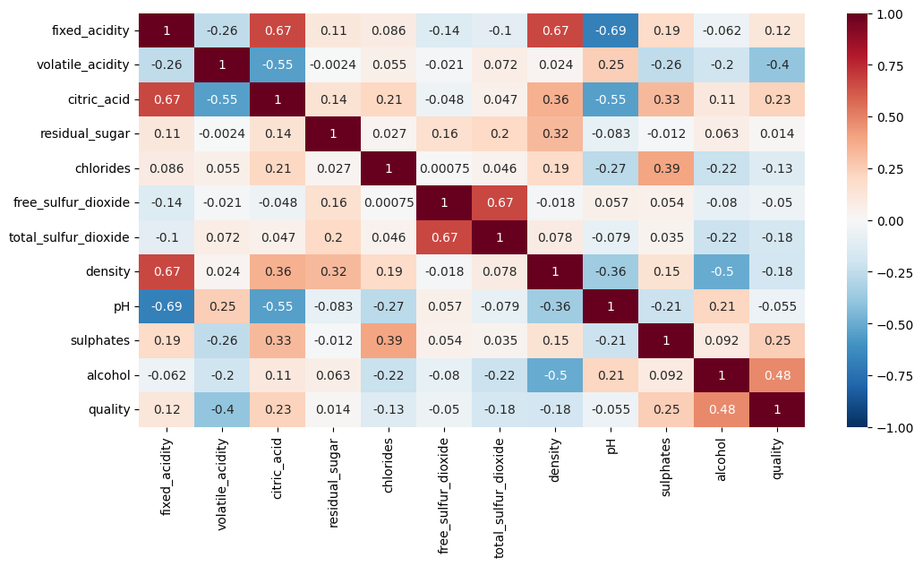
Correlation BetWEEn THE FACTORS
The factors have highest correlation are alcohol, sulphates, citric acid and fixed acidity

Slide 9
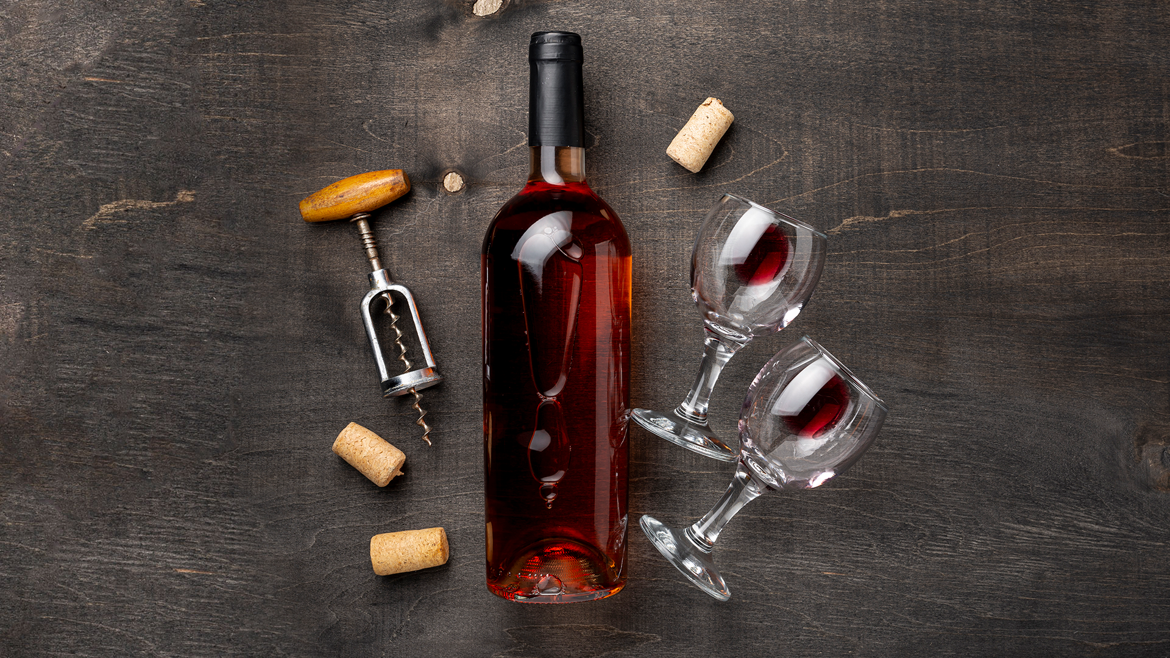
02.
Analysis of factors affecting red wine quality

Slide 10
FOUR main FACTORS
ALcohol
SuLPHATES
citric acid
fixed acidity
The alcohol content in wine affects its body, mouthfeel, and overall balance. Wines with well-integrated alcohol levels that harmonize with other components are often associated with higher quality.
Sulphates, commonly derived from sulfur dioxide, can impact the wine's aroma and flavor. Moderate levels of sulphates are often present in higher-quality wines.
Citric acid is a component of wine that can contribute to its freshness and enhance the overall quality. Wines with appropriate levels of citric acid are often perceived as having a good balance.
The amount of fixed acids in the wine, such as tartaric acid, can contribute to its overall perceived quality. Wines with a balanced acidity level are often considered of higher quality

Slide 11
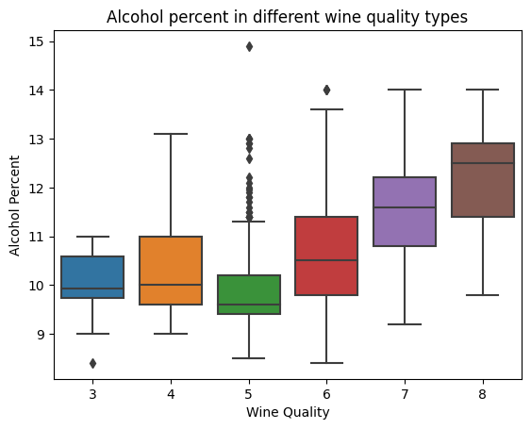
alcohol
The higher the alcohol content, the higher the quality of the wine, common from 10 to 13 percent

Slide 12
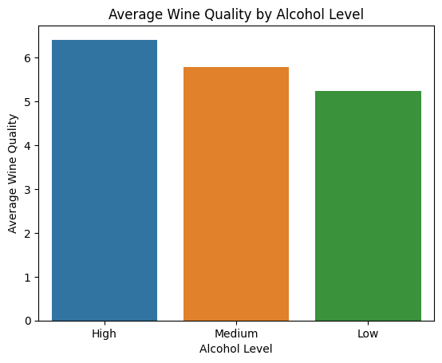
alcohol
High level alcohol (alcohol > 13%): wine quality > 6
Medium and low level alcohol (alcohol < 13%): wine quality > 5

Slide 13
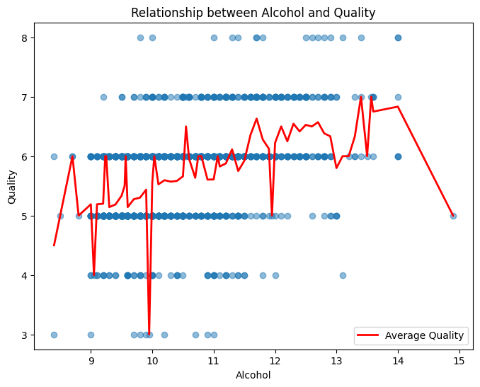
alcohol
The average quality of alcohol is mainly in the range of 5 to 7

Slide 14
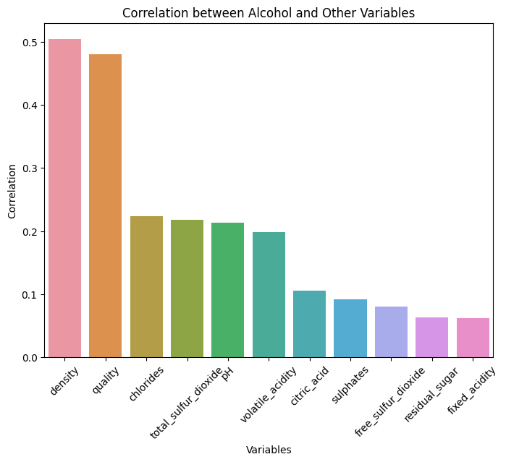
alcohol
Densitiy seems to decrease with alcohol content accross all quality wines
Variation of chlorides seems to be independent of alcohol content irrespective of the quality of wines

Slide 15
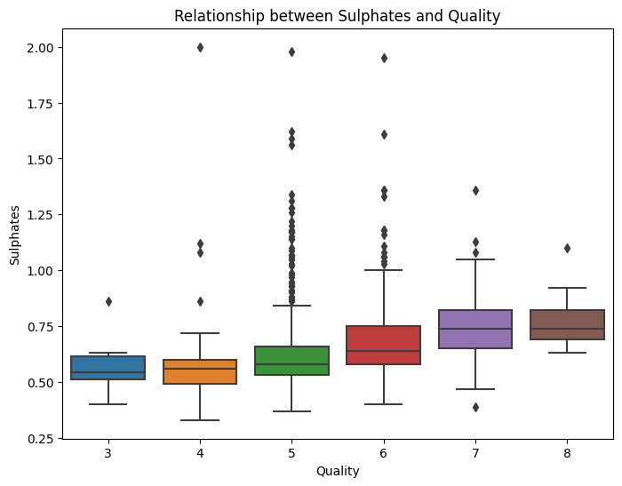
SULPHATES
The relation between sulphates and quality seem to be linearly positive, adding higher amounts of sulphates to these wines seem to get them higher quality ratings

Slide 16
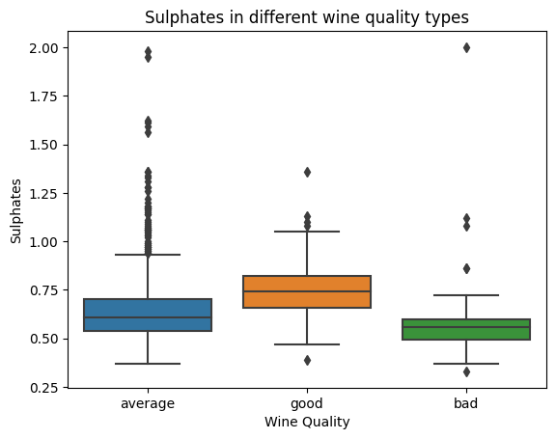
SULPHATES
The amount of sulphates ~ 0.75 for good quality wine, but if it is higher than 1 then it gives no value in improving wine quality

Slide 17
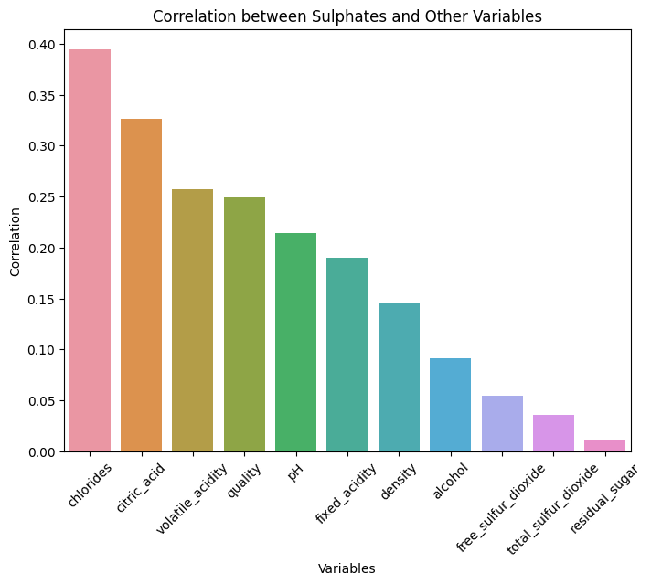
SULPHATES
Chlorides are the most influential factor on sulphates, the relationship between sulphates and quality is also relatively high

Slide 18
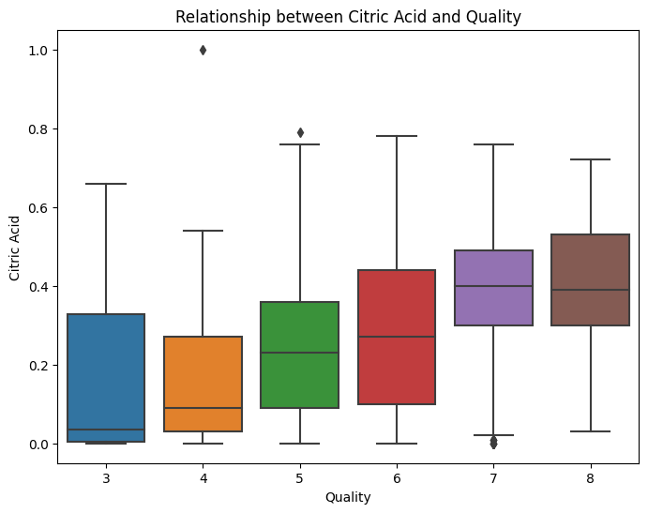
citric acid
We found that citric acid gives a wine its freshness
As this plot shows, the quality of wine increases when there is more citric acid present in the grapes

Slide 19
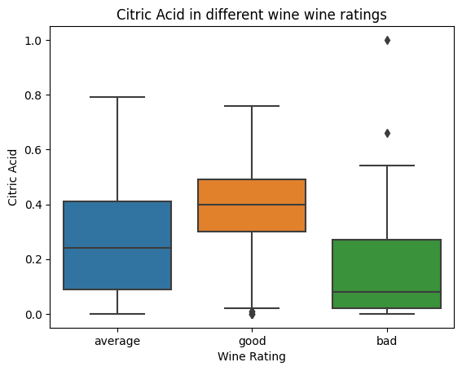
citric acid
Too much citric acid will result in a lower quality wine, the right balance (not too much and not too little) of citric acid additive results in higher quality wines
As this plot, citric acid value is ~ 0.4 is the threshold of good wine quality

Slide 20
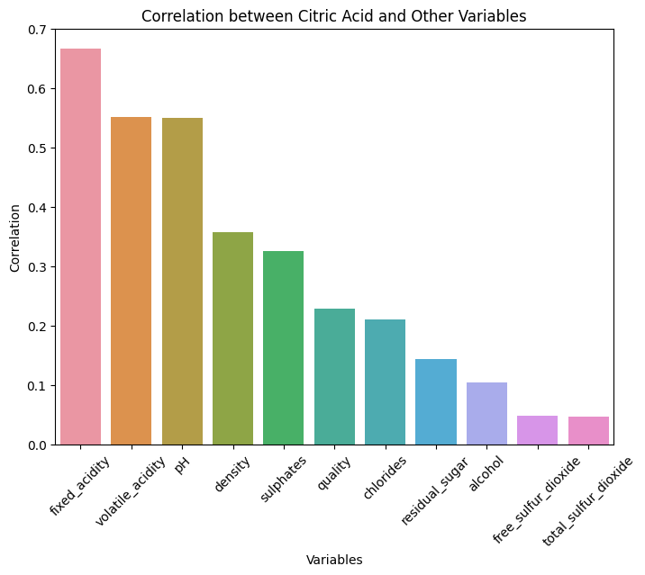
citric acid
Fixed acidity, volatile acidity and pH are the most influential factor on citric acid

Slide 21
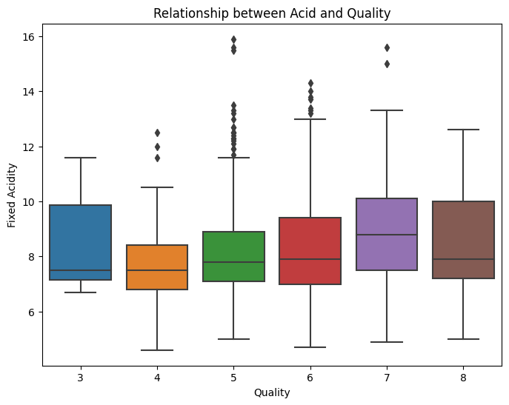
fixed acidity
Fixed acidity is positively correlated accross with quality wines
Fixed acidity is range from 4.6 to 15.9

Slide 22
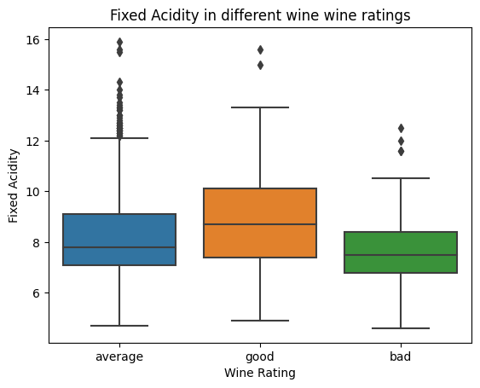
fixed acidity
The value of fixed acidity in good wine quality is 9 and not good is lower than 8

Slide 23
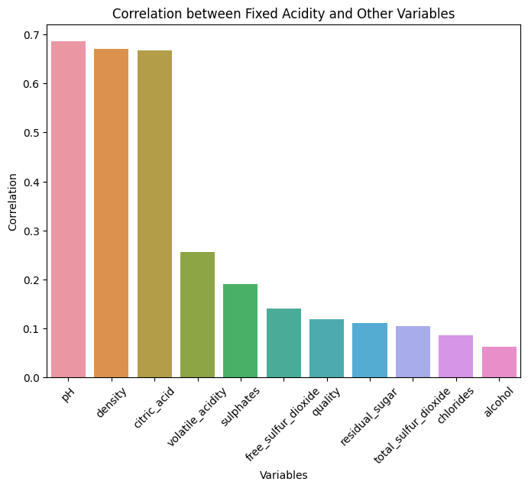
fixed acidity
In general fixed acidity decreases with pH accross all quality wines
Fixed acidity and density are positively correlated accross all quality wines. Shows tartaric acid plays a vital role in controlling the wine density

Slide 24
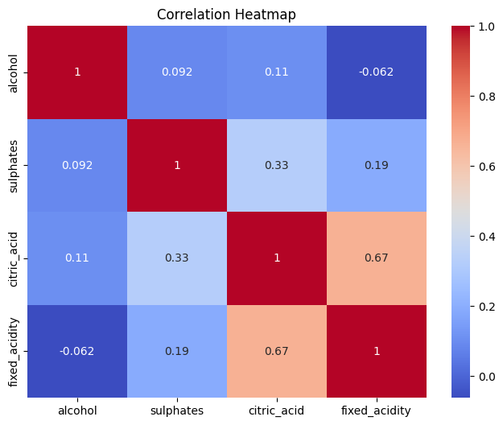
Correlattion between 4 factors
fixed acidity (a measure of tartaric acid), is correlated with citric acid
Citric acid and sulphates also have a certain correlation

Slide 25
03.
Predict red wine quality using machine learning model

Slide 26
Machine learning model
random forest
4
3
kmeans
Logistic regression
2
linear regrrssion
1

Slide 27
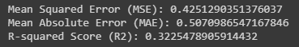
linear regression
The model explains 32% of the variability of the response data around its mean. This suggests that the model is not very effective at expressing the data

Slide 28
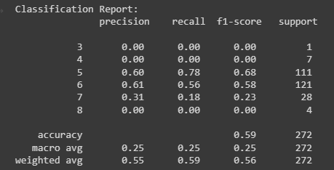
LOGISTIC regression
With an accuracy value of 58%, the logistic regresstion model is not suitable, it is only slightly higher than the coin toss probability

Slide 29
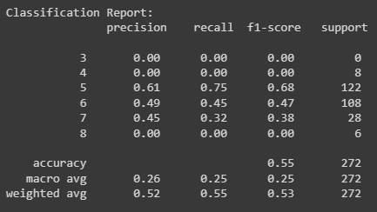
random forest
This sklearn's random forest classifier model also has the varian score around 26%, which is the similar with the linear gregession model

Slide 30
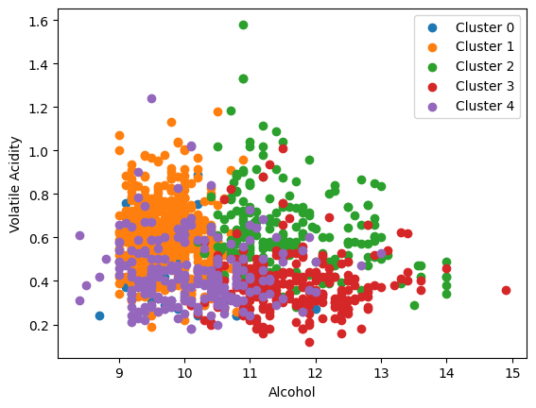
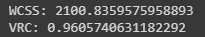
KMEANS
Score = 96% model fit with ~ 96% data. This is suitable model

Slide 31
conclusions
We observed the key factors that determine and affects the quality of the red wine is alcohol, sulphates, citric acid and fixed acidity
To make predictions of wine quality and any other if required, I use Kmeans models. The Kmeans performed marginally better and I decided to stick with it if we had to make any more predictions
The usage of this analysis will help to understand whether by modifying the variables, it is possible to increase the quality of the wine on the market. If you can control your variables, then you can predict the quality of your wine and obtain more profits

Slide 32
Thanks
Do you have any questions?

